Slide 1

Regression Metrics

Slide 2
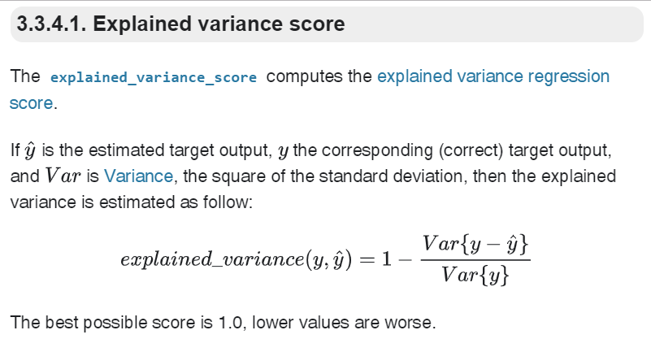
Estimates the deviation between prediction and actual values

Slide 3
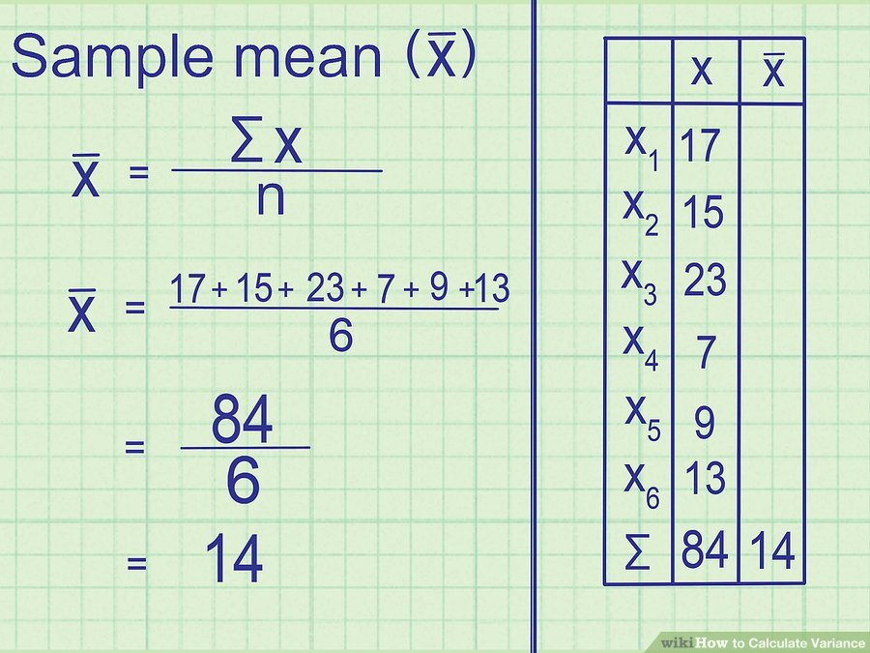
Variance Estimation

Slide 4
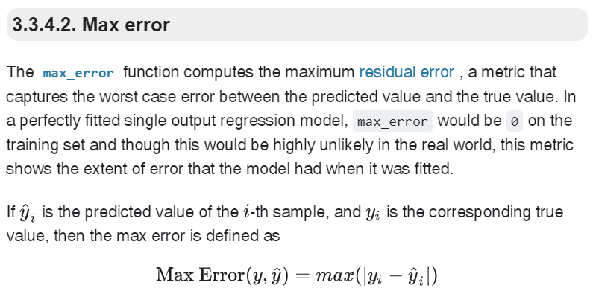
Aims to find what is the maximum error made by the model for a single sample… Finding a best model that covers all the samples

Slide 5
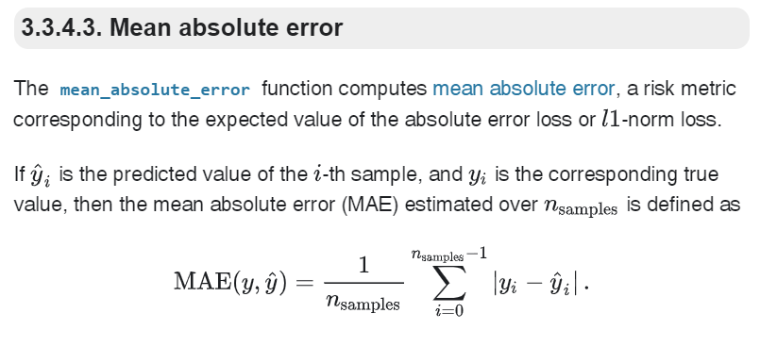
Does a poor job when scale of the data is high

Slide 6
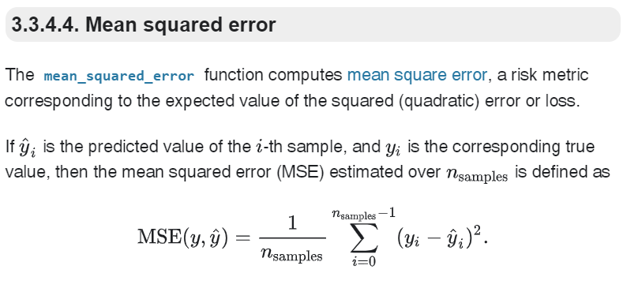
Squaring always gives a positive value, so the sum will not be zero.
Squaring emphasizes larger differences—a feature that turns out to be both good and bad (think of the effect outliers have).

Slide 7
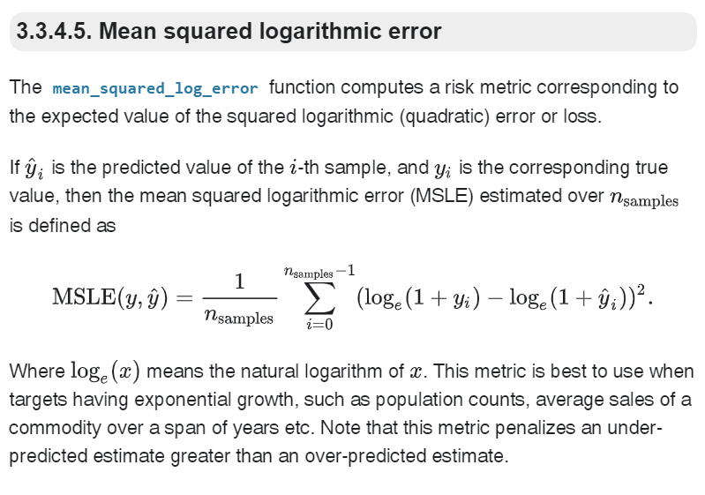
Useful when scale of prediction is too high, where log scales it down

Slide 8
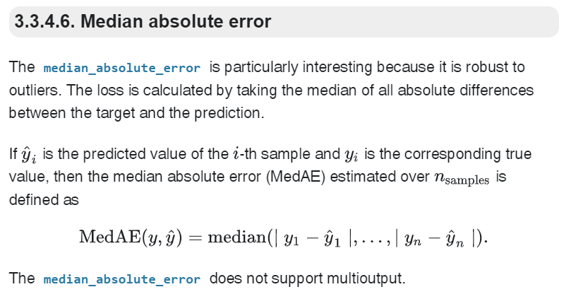
Prevents outliers contributing more error to the model evaluation

Slide 9
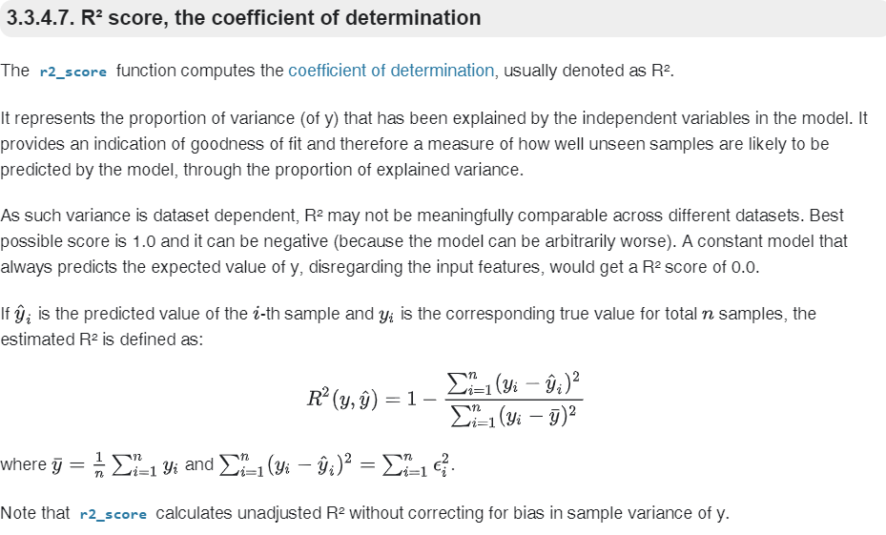
Very Popular one!

